Slide 1
Sat-to-Map
BACKUP SLIDES

Slide 2
Probable Reason for poor image reconstruction in case of VAEs
It is well known that CNNs and GANs have been extensively applied to problems involving image to image translations while VAEs are not used for such tasks
Injected noise and imperfect reconstructions lead to blurry images as compared to Generative Adversarial Networks.
Variational Autoencoder basically optimises the likelihood results into a probability density that is away from estimated data manifold.

Slide 3
A probable explanation for the poor performance of VAE might because this model could be overfitting, as the training and test error are quite close in magnitude but more than the desired error (and the errors in the case of GANs and CNNs).
Both these errors converge after few epochs and fail to reduce after that.
We can prevent this by changing the features (which we cannot change in our problem), and by increasing the features we take into consideration (this also we cannot do in our case)

Slide 4
Web-Scraping for obtaining data of Indian Landscapes
We used Selenium for web-scraping images of Indian Landscapes for the purpose of testing the already trained models on these pairs.
We web-scraped these pairs of maps and satellite images from Google Maps.

Slide 5
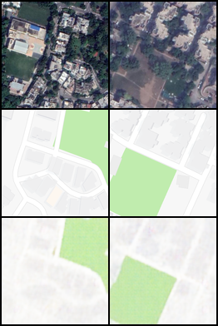
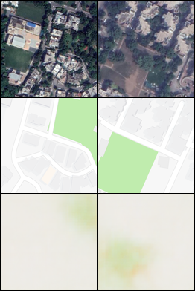
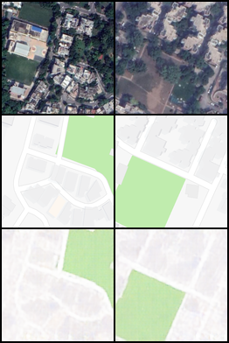
Results for web-scraping
Convolution Neural Network
Variational Auto Encoder
Generative Adversarial Network

Slide 6
L2 loss Pixelwise for different models
CNN after 500 epochs - 0.05
GAN after 500 epochs - 0.05
VAE even after 1500 epochs - 3.05

Slide 7
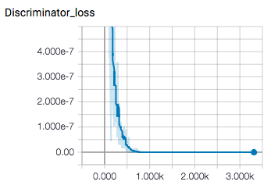
Discriminator Plots

Slide 8
Architecture of Generator
5 Convolution Layers
5 Corresponding Instance Normalization
ReLU Activation Functions
1 fully connected (Linear) layer

Slide 9
Architecture of Discriminator
5 Convolution Layers
5 Corresponding Instance Normalization
Leaky ReLU Activation Functions
1 fully connected (linear) layer

Slide 10
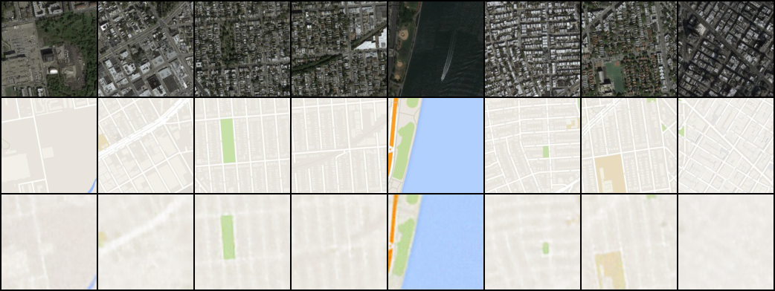
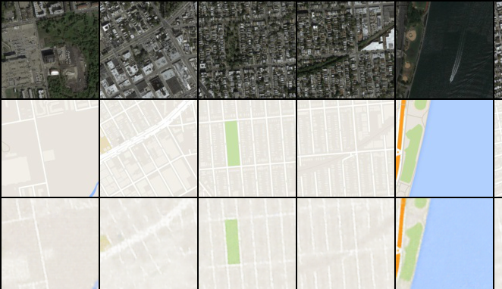
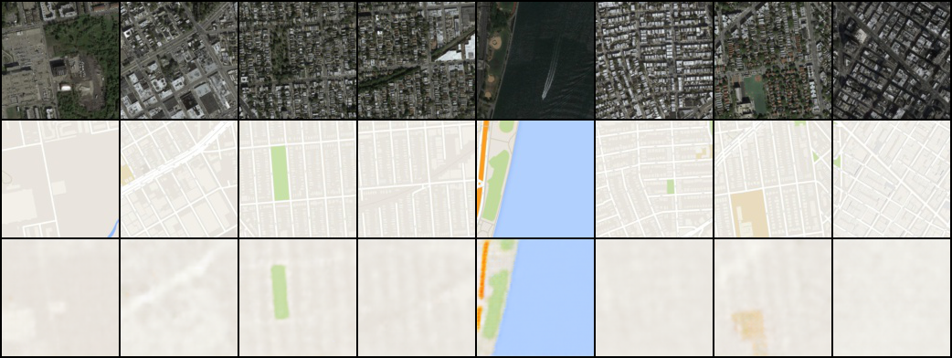
L1 Regulariser
L2 Regulariser

